Slide 1
Customer Personality Analysis

Slide 2
AGENDA
Objective
Background
Key findings
Recommendations
Appendix:
Data sources
Data methodology
Data assumptions

Slide 3
OBJECTIVE
To analyze customer demographics, spending behavior, and campaign participation to identify key customer segments and their preferences.
To understand the factors influencing total revenue, including web visits, non-web purchases, and customer response to campaigns.
To provide data-driven insights that help businesses optimize marketing strategies, enhance customer engagement, and maximize revenue growth.

Slide 4
BACKGROUND
Businesses collect vast amounts of customer data from various sources, including purchase history, demographics, and online interactions. However, without proper analysis, this data remains underutilized.
Customer Personality Analysis helps segment customers based on their behaviors, preferences, and spending patterns, allowing businesses to tailor marketing strategies and product offerings effectively.
By identifying high-value customer segments, companies can optimize resource allocation, improve customer satisfaction, and increase overall profitability.

Slide 5
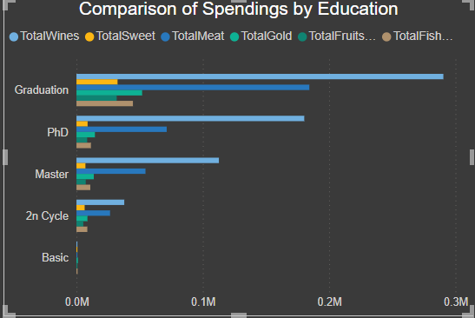
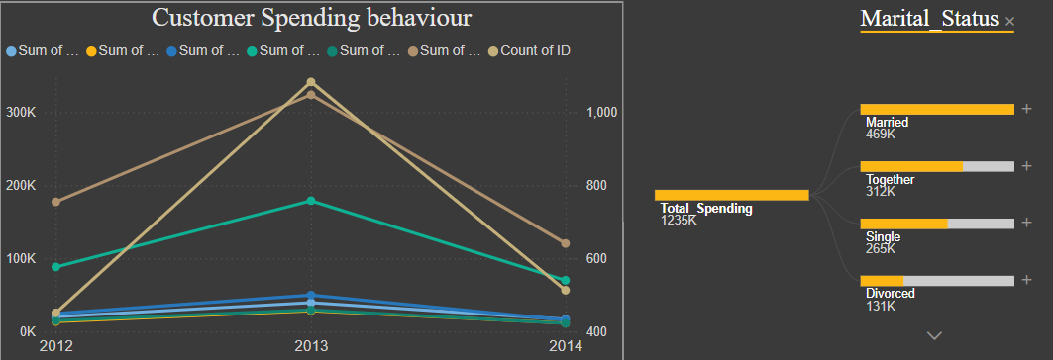
Spending Behaviour & Revenue Trends
Customer spending peaked in 2013 but declined in 2014 across all categories, reflecting a drop in both engagement and purchase volume.
Education and marital status significantly influence spending—graduates and married individuals are the highest spenders.
Wine remains the top category across education levels, while total customer spending far exceeds total revenue, indicating a financial imbalance.

Slide 6
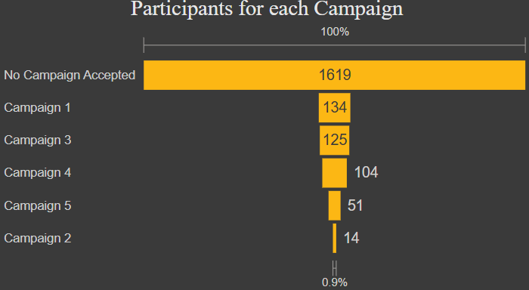
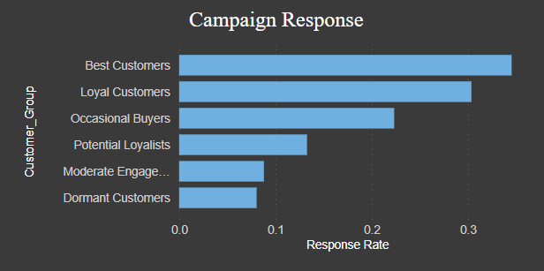
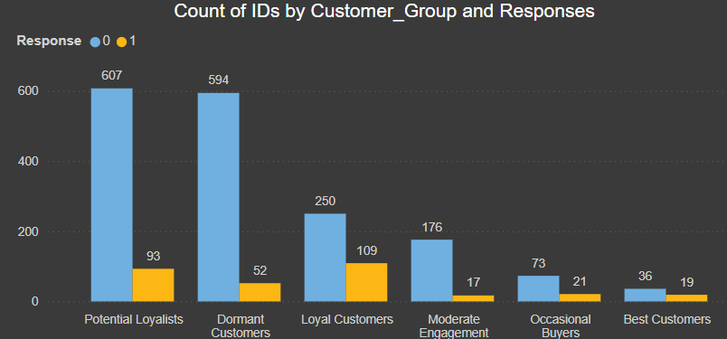
Campaign Performance & Customer Engagement
Over 90% of customers did not accept any campaign, indicating a major issue with campaign relevance, timing, or delivery strategy.
Despite being smaller in number, Best and Loyal Customers showed the highest engagement, proving they are the most responsive and valuable targets for future campaigns.
Campaigns were mostly directed at Potential Loyalists and Dormant Customers, who showed low actual response, revealing a clear disconnect between targeting and conversion.

Slide 7
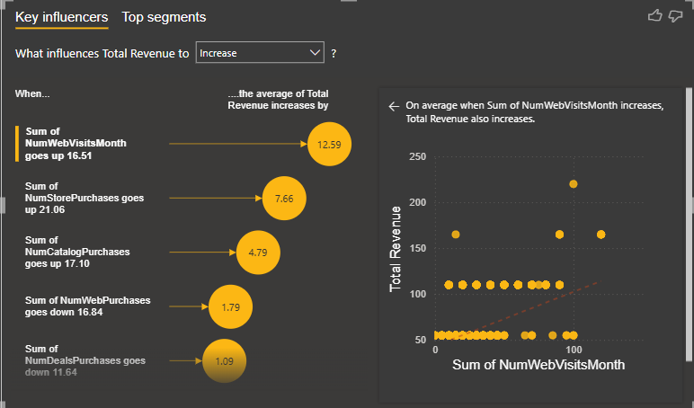
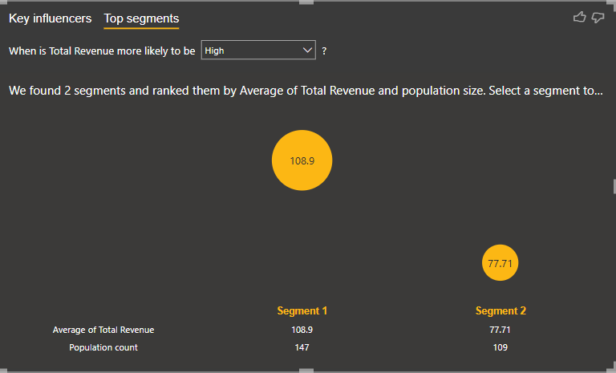
Factors Influencing Revenue
Web traffic and non-web purchases are key drivers of revenue—higher web visits and more non-web purchases lead to increased revenue.
Segment 1 and Segment 2 customers generate the highest total revenue and have the largest customer base, making them the most valuable targets.
While Segment 5 has the highest revenue per customer, its small population suggests that factors other than customer volume influence revenue generation

Slide 8
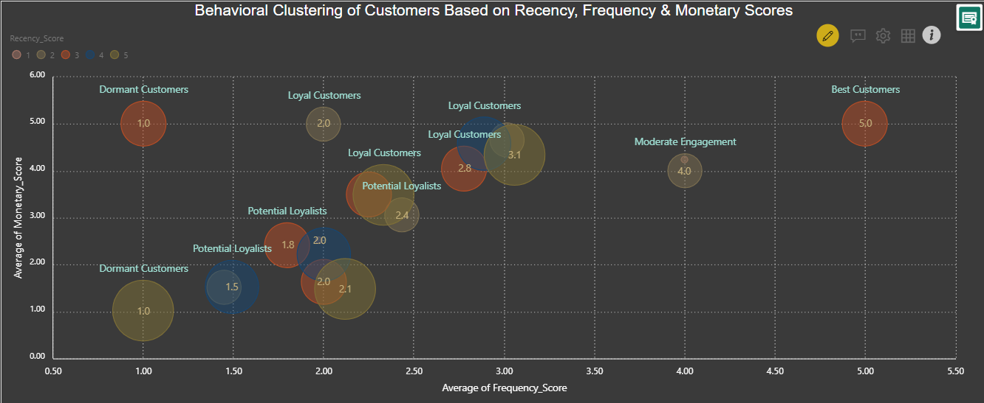
Customer Behavior Clusters: Spending vs. Purchase Frequency
High-frequency buyers spend more, while Dormant Customers contribute the least. Potential Loyalists have high spending but need retention efforts.
Lower recency correlates with lower spending, requiring timely reactivation. Best Customers maintain strong engagement through frequent purchases.
Dormant Customers need personalized reactivation, Potential Loyalists benefit from promotions, and Best Customers thrive on loyalty programs.

Slide 9
RECOMMENDATIONS
Personalize Campaign Strategies for Better Engagement.
Maximize Best Customer Value and Boost Revenue.
Target High-Spending, High-Value Segments.
Reactivate Dormant Customers and Reduce Churn.
Monitor Spending Trends and Correct Revenue Imbalances.
Create Family and Relationship-Based Offers

Slide 10
APPENDIX - DATA SOURCES
Primary Data Source:
The dataset was obtained from an internship website, containing marketing campaign data
in Excel format.
Dataset Content:
Includes customer demographics, purchasing behavior, campaign participation, web visits, and total spending/revenue.

Slide 11
APPENDIX - DATA METHODOLOGY
Removed duplicate and invalid entries to ensure data accuracy.
Standardized and categorized customer demographic and behavioral data.
Calculated total spending, order frequency, and revenue distribution across customer segments.
Applied statistical methods to identify spending patterns and campaign effectiveness.
Used Power BI and Python (Matplotlib, Seaborn) for data visualization.
Segmented customers based on spending behavior, demographics, and campaign responses.

